Slide 1
Empowering Rehabilitation Researchers Through Data Science, Reproducibility, and Data Visualization
Journal of neurologic Physical Therapy:
George Fulk, Grace Bellinger, Allison Miller, Andrew Hooyman, and Keith Lohse

Slide 2
JNPT Updates
Lori Quinn as our new Editor in Chief
Guidelines for Reviewers
Key aspects of the manuscript to consider
Significance
Approach
Novel Contribution to the Literature
Guiding videos
Instructions for Authors
Statistical Reporting Guidelines

Slide 3
Objectives
By the end of this session, attendees will be able to:
Describe data science and the importance of reproducibility in rehabilitation research
Explain reproducible research pipelines and their benefits, including actionable take-aways that can be implemented tomorrow
Understand best practices for data visualization and apply these techniques to view and interpret data
Access resources to facilitate reproducibility and data visualization

Slide 4
Session Outline
11:00 – 11:25 Introduction to data science and the importance of reproducibility
11:25 – 12:00 Data management and quality control
12:00 – 12:25 Data visualization for communication
12:25 – 12:50 (Data) Sharing is caring
12:50 – 13:00 Q&A

Slide 5
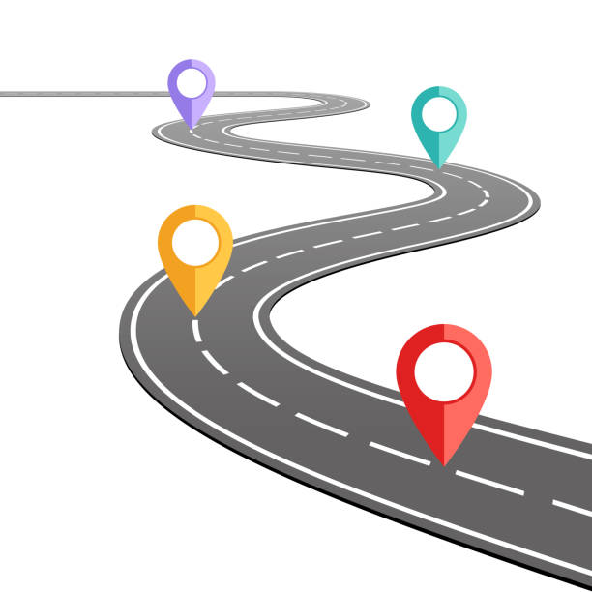
Data Sharing and Re-Use
Communicating Data through Visualization
Data Collection & Quality Control
Planning for Dissemination: Leveraging Data Science to Improve Reproducibility
Key Milestones in the Pathway to Publication
Notes:
Planning for dissemination/overview of data science and reproducibility: Grace
Data collection and quality control – Allison
Communicating data through visualization- Andrew
Data sharing and re-use- Keith

Slide 6

Introduction to Data Science and the Importance of Reproducibility
Grace C. Bellinger, PhD, MPH (she/her/hers)

Slide 7

Outline
Overview of data science
Introduction to reproducibility
Opportunities for improvements in reproducible research practices
Lessons learned from retracted articles

Slide 8
Data Science
Data Science is an interdisciplinary field which uses statistics, computer science, programming, and domain knowledge to collect, process, and analyze data for the purpose of acquiring knowledge or solving a problem. Data science also includes sharing acquired knowledge through storytelling, visualization, and other means of communication. Data science often employs methods such as machine learning, AI, natural language processing, algorithms, and other analytic tools to process and understand data.
Source: National Library of Medicine

Slide 9
Reproducibility
 |  | Data
 |  | Same | Different
Methods | Same | Reproducible | Replicable
 | Different | Robust | Generalizable

Slide 10
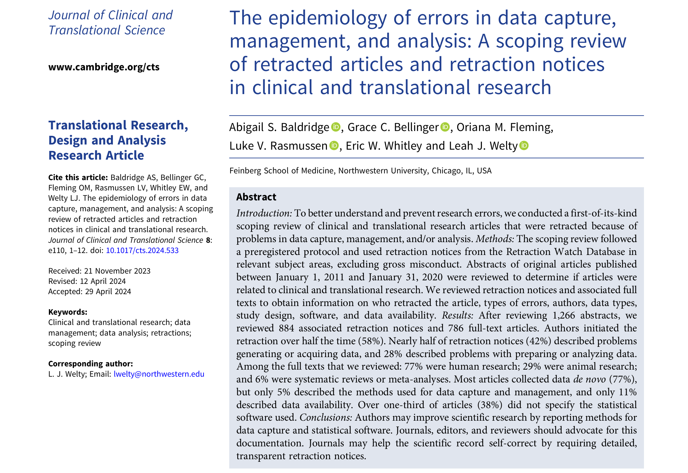

Slide 11
Scoping Review Rationale
21% to 62% of retractions are related to unintentional errors
Research is becoming increasingly complex
No previous comprehensive study of articles in the biomedical literature that were retracted owing to mistakes in data capture, management, and/or analysis
Characterizing methodological and analytic mistakes is an essential step in improving their detection and prevention

Slide 12
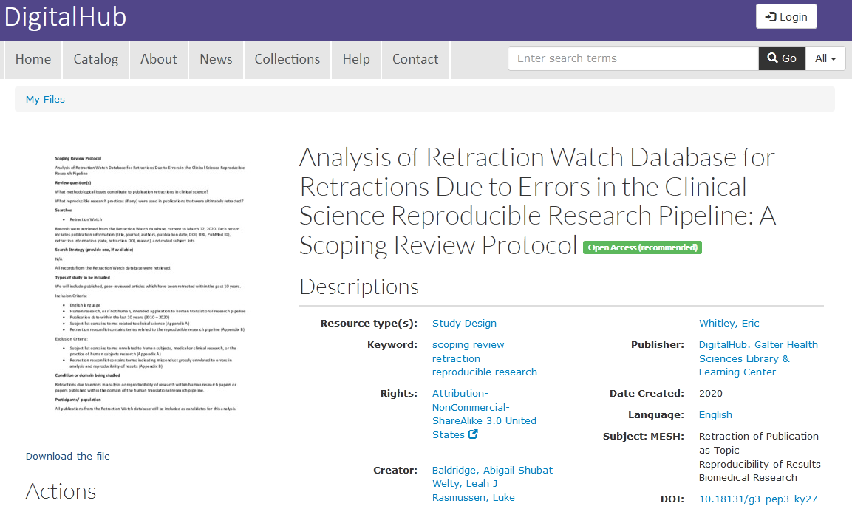
Methods
Scoping review complied with PRISMA-ScR guidelines
Checklist included in supplement
Followed a preregistered protocol

Slide 13

Retraction Watch
Website launched in 2010
Became part of the Center for Scientific Integrity in 2014
Retraction Watch Database launched in 2018
Systematic and comprehensive compendium of retracted articles
Detailed ontology to classify and describe the retracted articles
Previously required a data use agreement
Acquired by Crossref in 2023

Slide 14
Methods
REDCap used for data entry and import
Abstracts assessed by 2 reviewers
Qualitative review of retraction notices
Retraction reasons coded by 2 reviewers
Generating or acquiring data: instrumentation problems, misidentified patients, incorrect data entry
Preparing or analyzing data: misclassification errors, inappropriate statistical methods
Full text review
5% reviewed in duplicate

Slide 15
CONSORT Diagram

Slide 16
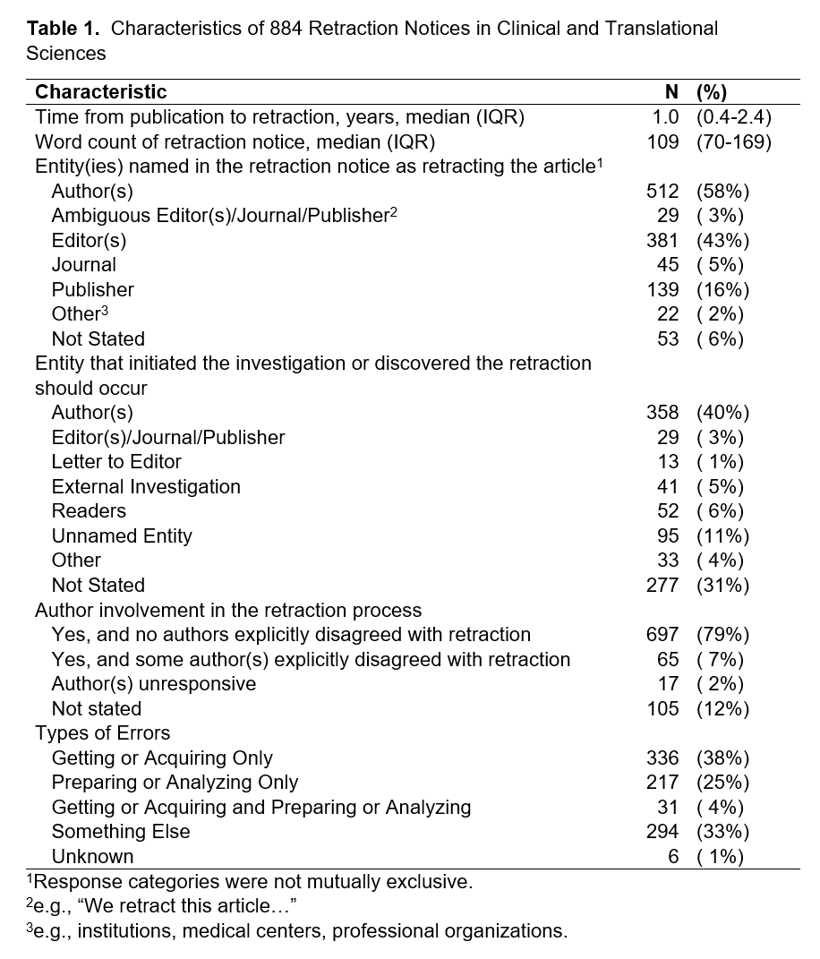
Retraction Notices
Median time from publication to retraction was 1 year
Author involvement in the retraction process was common
1/3 of retraction notices did not state who initiated the retraction
42% of retraction notices described problems with generating or acquiring data
28% of retraction notices described problems with preparing or analyzing data

Slide 17
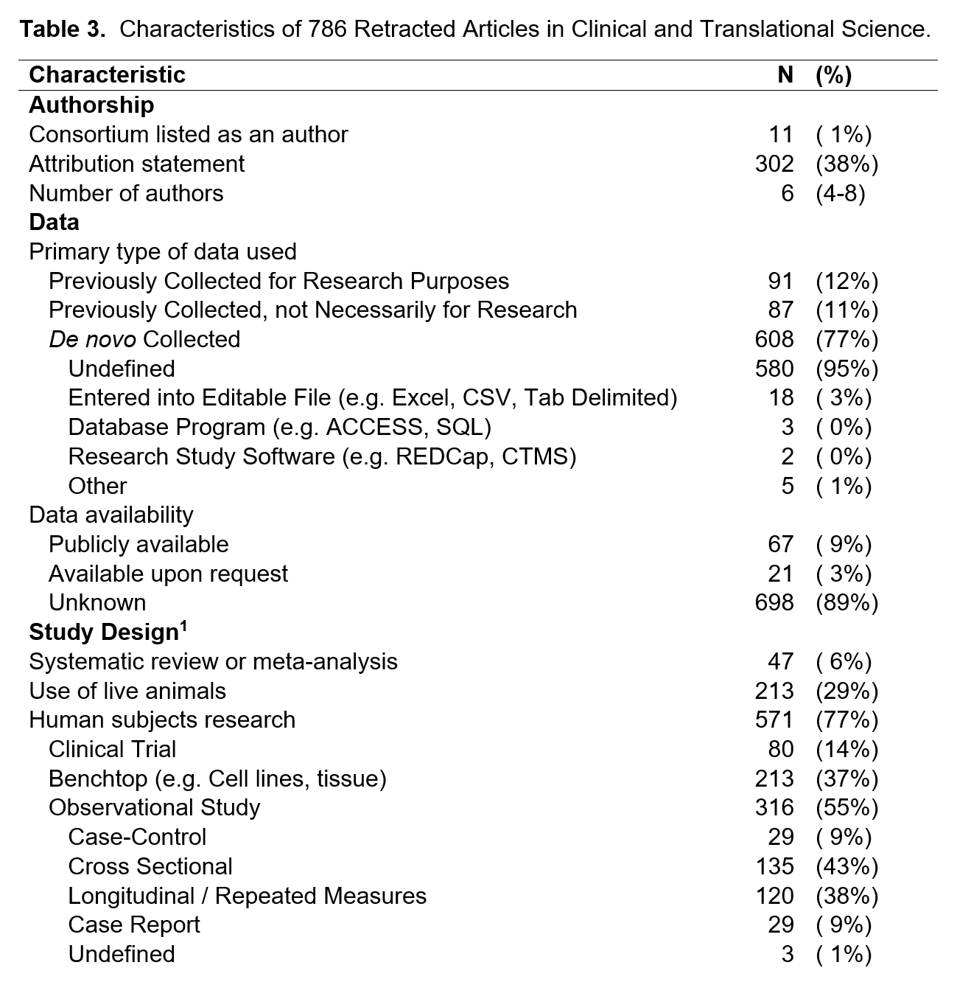
Retracted Articles
38% stated authors’ contributions
More than ¾ of articles reported collecting data de novo, but 95% of those did not describe methods for data collection or storage
Fewer than 1 in 10 included data that were publicly available
Less than 3% stated data were available upon request
About ¾ of articles included human research

Slide 18
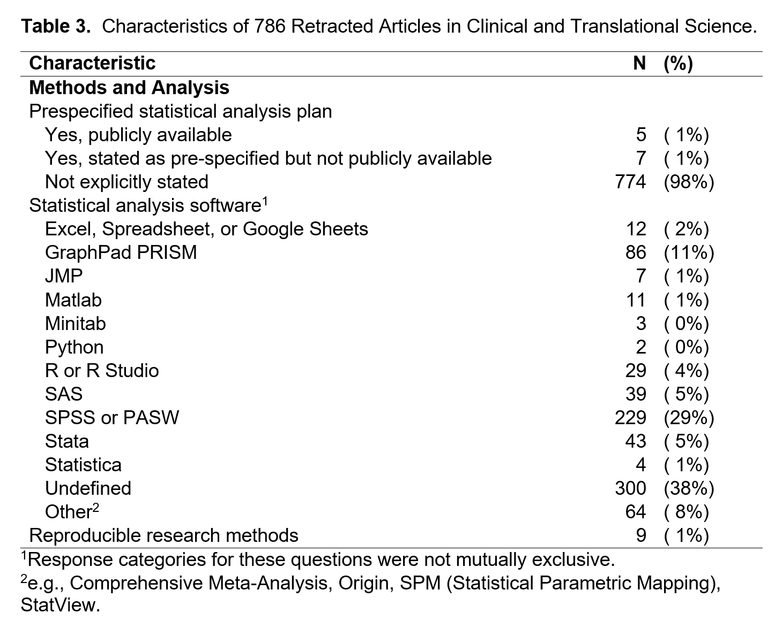
Retracted Articles
More than 1/3 did not specify the statistical analysis software used
The most common programs were SPSS/PASW and GraphPad PRISM
Statistical software such as Stata, SAS, or R/R Studio were infrequently reported
12 articles mentioned a prespecified statistical analysis plan
9 articles mentioned additional tools to support reproducibility and transparency

Slide 19
“The randomized trial involved 72 patients between two participating centers. The published article includes 100 patients. The authors added 28 patients to show statistically that there was no difference in the main outcomes measures despite changing the sample size to 100 patients. The 28 patients with large pancreatic masses were subjects of another similar randomized trial… that has not been published or findings analyzed; the authors do not intend to publish the findings of that trial.”
“143 cases of the 339 cases analyzed did not fit the criteria for patient selection.”
“…a database was utilized with mistakes in coding of players and injuries. This resulted in errors in the count of injuries, exposure and therefore their incidence.”
“Substantial number of patients in the study underwent postoperative follow-up with PET alone instead of PET/CT. PET/CT was installed in our institution in 2009 and PET (without CT component) was used before 2009. The authors misunderstood that all the patients in this study underwent PET/CT, but recently realized that this was incorrect.”
“…the reported results are based on a confused data set according to a recent notification by the authors. Instead of the original data of the actual study, data from a previous publication of the same group have been erroneously analyzed.”

Slide 20
“…data of two different hospitals got terribly mixed…”
“While there are no concerns about the data themselves, the experimental and control groups were inadvertently switched during the original analysis. This error unfortunately lead to the opposite results being reported.”
“While applying the same analyses to another dataset, the authors discovered that a systematic human error in coding the name of the files had been made during the extraction of the EEG template topographic maps best differentiating the two experimental conditions at the single subject level. Because the subsequent processing steps were based on these EEG maps, this error has ultimately modified the final result of the paper, which is therefore not correct.”
“…data that was input in SPSS is from another questionnaire.”
“…the automated algorithm that we used to track patient progress sometimes failed to recognize remissions or recoveries that occurred or it recognized only later instances.”
“…incorrect cohort identification (ie, we missed many patients who were eligible for cardiac rehabilitation). We did not query all relevant codes used to identify the cohort of patients with ischemic heart disease. For example, some International Classification of Diseases, Ninth Revision (ICD-9), procedure codes were not included in the initial query.”
“…the names of some of the items reported in the Measures section of the paper could not be correct because such items did not exist in the surveys. The authors tried to identify exactly which items had been used in the data analyses but they could not establish without some doubt exactly which items had actually been used.”

Slide 21
“…the merge of laboratory results and other survey data used in the paper resulted in an error regarding the identification codes…”
“We regret that there was an error in the analytic code used to compute oscillatory power in our article… The data matrix was oriented correctly for the call to eegfilt, but the output of the call to eegfilt was not correctly transposed in the standard Matlab format before passing into the built-in Matlab 'hilbert' function, as the EEGLAB function 'eegfilt' and the built-in Matlab function 'hilbert' require the data matrix to have different dimensions in order to operate correctly across time.”
“The process involved merging a variable (presence or absence of syncope) from one electronic source with an alternate electronic database of patients with pulmonary arterial hypertension and assessing associations and outcomes. …identified a 'cut-and paste' error in which the column of syncope data was transferred incorrectly where syncope/no syncope variables were assigned to wrong subjects. This led to a critical error that then got carried forward and a fundamental misclassification of syncope in the final study group.”
“…the authors discovered an error in the code for analyzing the data. The National Health and Nutrition Examination Survey (NHANES) medication data file had multiple observations per participant and was merged incorrectly with the demographic and other data files.”
“…a miscalculation in the weight of one of the urban areas in the study, affecting the national estimates for rates of hospital admission, …median length of hospital stay, in-hospital mortality, outcomes…”

Slide 22
“…the MATLAB script that was used for the analysis of reaction times in the pigeon paradigm was wrongly indexed.”
“After performing multiple imputation of missing data, the categorization of some patients changed, leading to changes in odds ratios for metastasis in all 4 staging systems.”
“…we had miscoded the NHANES variable of trying to lose weight by missing a skip pattern that started in the 1999-2000 survey.”
“When conducting the analysis, some of the country dummy variables were incorrectly generated in Excel prior to analysis in R.”
“These data were not reverse scored as intended prior to analyses.”
“The identified programming error was in a file used for preparation of the analytic data sets for statistical analysis and occurred while the variable referring to the study "arm" (ie, group) assignment was recoded. The purpose of the recoding was to change the randomization assignment variable format of "1, 2" to a binary format of "0, 1." However, the assignment was made incorrectly and resulted in a reversed coding of the study groups.”
“…a line was omitted from the data sheet; this was due to a bug in the analysis scripts. This resulted in shifting labels, and incorrect label annotation files for 10 out of 100 samples.”
“…that the code created to manually anonymize the data was accidentally run twice. During the first run, anonymized subject identifiers were successfully assigned to both biosamples and clinical data. However, after this first run had passed quality control checks, the anonymization code was re-run inadvertently, replacing the first correct set of identifiers with a random and incorrect set.”

Slide 23
“…authors noticed a discrepancy between the analyses as described (intention-to-treat analysis) and the analyses as performed.”
“…it became evident that the statistical approach for the primary outcome(s) was flawed. For analysis of repeatedly-assessed time-related data, the authors used comparison of groups at identical time points. This form of cross-sectional comparison at individual time points is not appropriate as it fails to account for patient variability. Traditional repeated-measures ANOVA can also not be used as the process fails to account for correlation among repeated measurements in individual patients. Therefore a mixed modelling approach should have been used.”
“The retraction has been agreed to because the statistical analysis was not correct given the cluster-randomized design, and the wrong degrees of freedom were used. The conclusion that the original paper drew about having demonstrated treatment efficacy was not supported in the corrected analysis.”
“Excel software was used to calculate the p-values. On recalculation using a newer version of the programme, the values are coming back different.”
“…there are baseline differences between the groups that exist despite randomization for which analyses were not controlled.”

Slide 24
Takeaways from Scoping Review
Need for greater attention to data acquisition and storage
Data sharing is expected to become more common as journals and funding agencies require it
Perform documentation as if the data will be shared
Use or develop reproducibility checklists
Include statisticians on research teams

Slide 25
Your Role in Reproducibility
Authors have the opportunity to improve the rigor of scientific research by reporting methods for data capture and management, statistical software, and other software tools or code sharing that support transparency and reproducibility.
Journals, editors, and peer reviewers can contribute to these improvements by advocating for widespread adoption of this documentation.
Journals have the opportunity to help the scientific record self-correct by requiring detailed, transparent retraction notices.

Slide 26
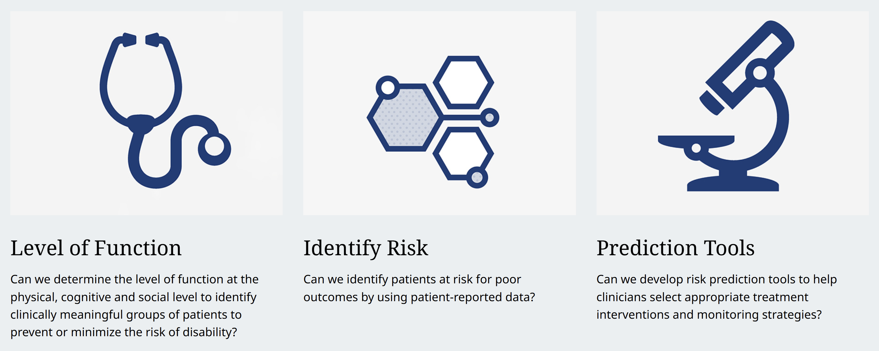
✉︎ gbellin1@jh.edu

Slide 27

Thank You
Scoping Review Team
Abigail Baldridge, DrPH, MS
Oriana Fleming, MPH
Luke Rasmussen, MS
Eric Whitley
Leah J. Welty, PhD
ReproRehab Program
George Fulk, PT, PhD
Keith Lohse, PhD, Pstat
Andrew Hooyman, PhD, Gstat
Allison Miller, PT, DPT, PhD
NIH/NICHD R25HD105583

Slide 28
Data Sharing and Re-Use
Communicating Data through Visualization
Data Collection & Quality Control
Planning for Dissemination: Leveraging Data Science to Improve Reproducibility
Key Milestones in the Pathway to Publication
Notes:
Planning for dissemination/overview of data science and reproducibility: Grace
Data collection and quality control – Allison
Communicating data through visualization- Andrew
Data sharing and re-use- Keith

Slide 29
Data Management and Quality Control
Allison Miller, PT, DPT, PhD, NCS
Washington University School of Medicine in St. Louis

Slide 30
What is quality control of data and why does it matter?
“Behind every great research project is great data management” – Kanza & Knight, BMC Research Notes, 2022
Minimizes risk for errors, article retraction (as we just saw from Grace)
Prepares you to share your data more easily and confidently (more on this from Keith later)

Slide 31
There are lots of opportunities for things to go wrong in the data life cycle
Data Management
System
Data Collection
Data Processing
Data Inspection
Data Analysis
Making these processes as seamless and automatic as possible = high quality data
Notes:
Focusing on steps leading up to data analysis

Slide 32
There are lots of opportunities for things to go wrong in the data life cycle
Data Management
System
Data Collection
Data Processing
Data Inspection
Data Analysis
Making these processes as seamless and automatic as possible = high quality data
Notes:
Focusing on steps leading up to data analysis

Slide 33

Data Management System
Research Study
Not Ideal:
Not having one
Inconsistent file structure and names
Participants
Participant_1
Left_Sensor.csv
Right_Sensor.csv
Subject 2
L sensor.csv
R sensor.csv
ParticipantID 3
LeftSensorID3.csv
RightSensorID3.csv
Notes:
Not having one- research team members left to come up with their own file structure/naming, can be particularly problematic when multiple team members are involved with managing and collecting data
Examples of bad file structure, different names
Want to be machine readable
Keep consistent across studies

Slide 34
Data Management System
Research Study
Ideal:
Organized
Consistent file structure and names
Machine-readable
Participants
Participant_1
1_LeftSensor.csv
1_RightSensor.csv
Participant_2
2_LeftSensor.csv
2_RightSensor.csv
Participant_3
3_LeftSensor.csv
3_RightSensor.csv

Slide 35
There are lots of opportunities for things to go wrong in the data life cycle
Data Management
System
Data Collection
Data Processing
Data Inspection
Data Analysis
Making these processes as seamless and automatic as possible = high quality data
Notes:
Focusing on steps leading up to data analysis

Slide 36


Data Collection
Not Ideal:
Unclear (or non-existent) documentation that describes data collection procedures
Ideal:
Clear, detailed manual of operating procedures describing how data will be collected
Collect
data
Notes:
Quick comment, not as much of a focus

Slide 37
There are lots of opportunities for things to go wrong in the data life cycle
Data Management
System
Data Collection
Data Processing
Data Inspection
Data Analysis
Making these processes as seamless and automatic as possible = high quality data
Notes:
Focusing on steps leading up to data analysis

Slide 38
Data Processing and Inspection
Not Ideal:
Lack of documentation/clarity for data processing procedures
No guard rails to protect against errors
Delayed opportunities to correct for errors
Ideal:
User-friendly (e.g., data visualization)
Built-in checks for errors
More immediate opportunities to correct errors
Notes:
Andrew will talk about visualizing data for publication purposes; here, we are focusing on using data visualization to inspect incoming data as a quality control step

Slide 39
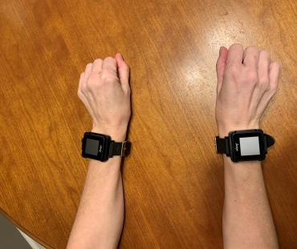
Automated Quality Control Example
Research participants wear bilateral wrist accelerometers
We are processing data from an individual with stroke who has right-sided hemiparesis

Slide 40
Automated Quality Control Example
Where are the opportunities for errors and what steps can be taken to check for these?
Checkpoint 1:
Do data appear to have been collected correctly?
Checkpoint 2:
Does the data point of interest appear reasonable compared to other data?
Documentation that data point was inspected and any follow-up required

Slide 41
Automated Quality Control Example
Where are the opportunities for errors and what steps can be taken to check for these?
Checkpoint 1:
Do data appear to have been collected correctly?
Checkpoint 2:
Does the data point of interest appear reasonable compared to other data?
Documentation that data point was inspected and any follow-up required

Slide 42
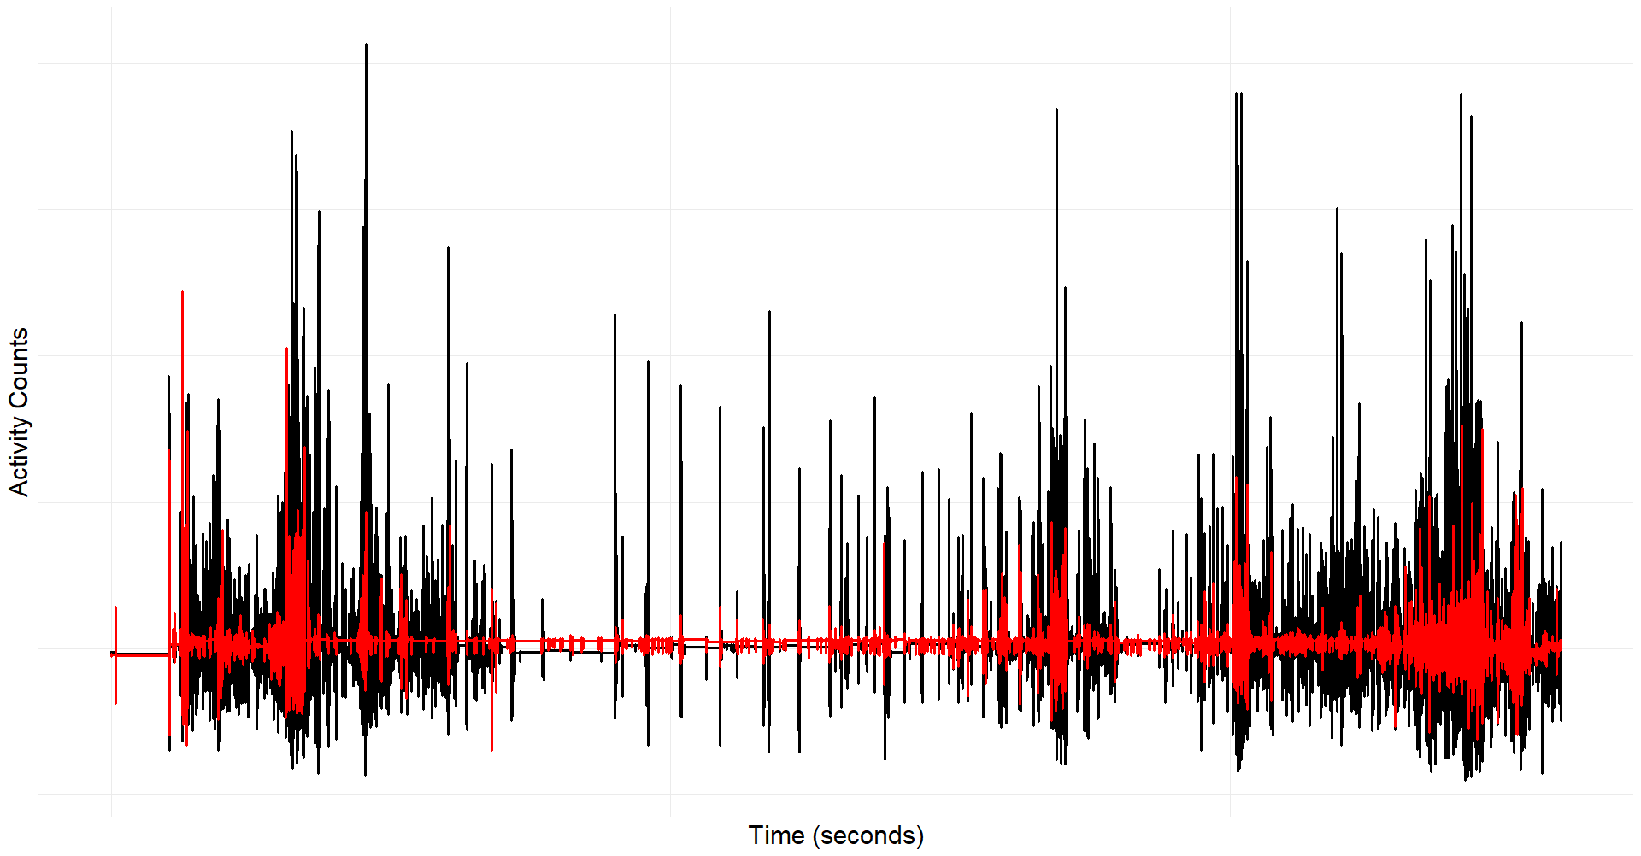
Automated Quality Control Example
Data from
LEFT sensor
Data from RIGHT sensor
Bilateral wrist accelerometry data from a participant with stroke with right hemiparesis

Slide 43
Automated Quality Control Example
Data from
LEFT sensor
Data from RIGHT sensor
Bilateral wrist accelerometry data from a participant with stroke with right hemiparesis
What do we think of these data?
1. Data look reasonable, proceed to next step
-OR-
2. Data do not look reasonable- further investigation required before proceeding

Slide 44
Automated Quality Control Example
Data from
LEFT sensor
Data from RIGHT sensor
Bilateral wrist accelerometry data from a participant with stroke with right hemiparesis
What do we think of these data?
1. Data look reasonable, proceed to next step
-OR-
2. Data do not look reasonable- further investigation required before proceeding

Slide 45
Automated Quality Control Example
Where are the opportunities for errors and what steps can be taken to check for these?
Checkpoint 1:
Do data appear to have been collected correctly?
Checkpoint 2:
Does the data point of interest appear reasonable compared to other data?
Documentation that data point was inspected and any follow-up required

Slide 46
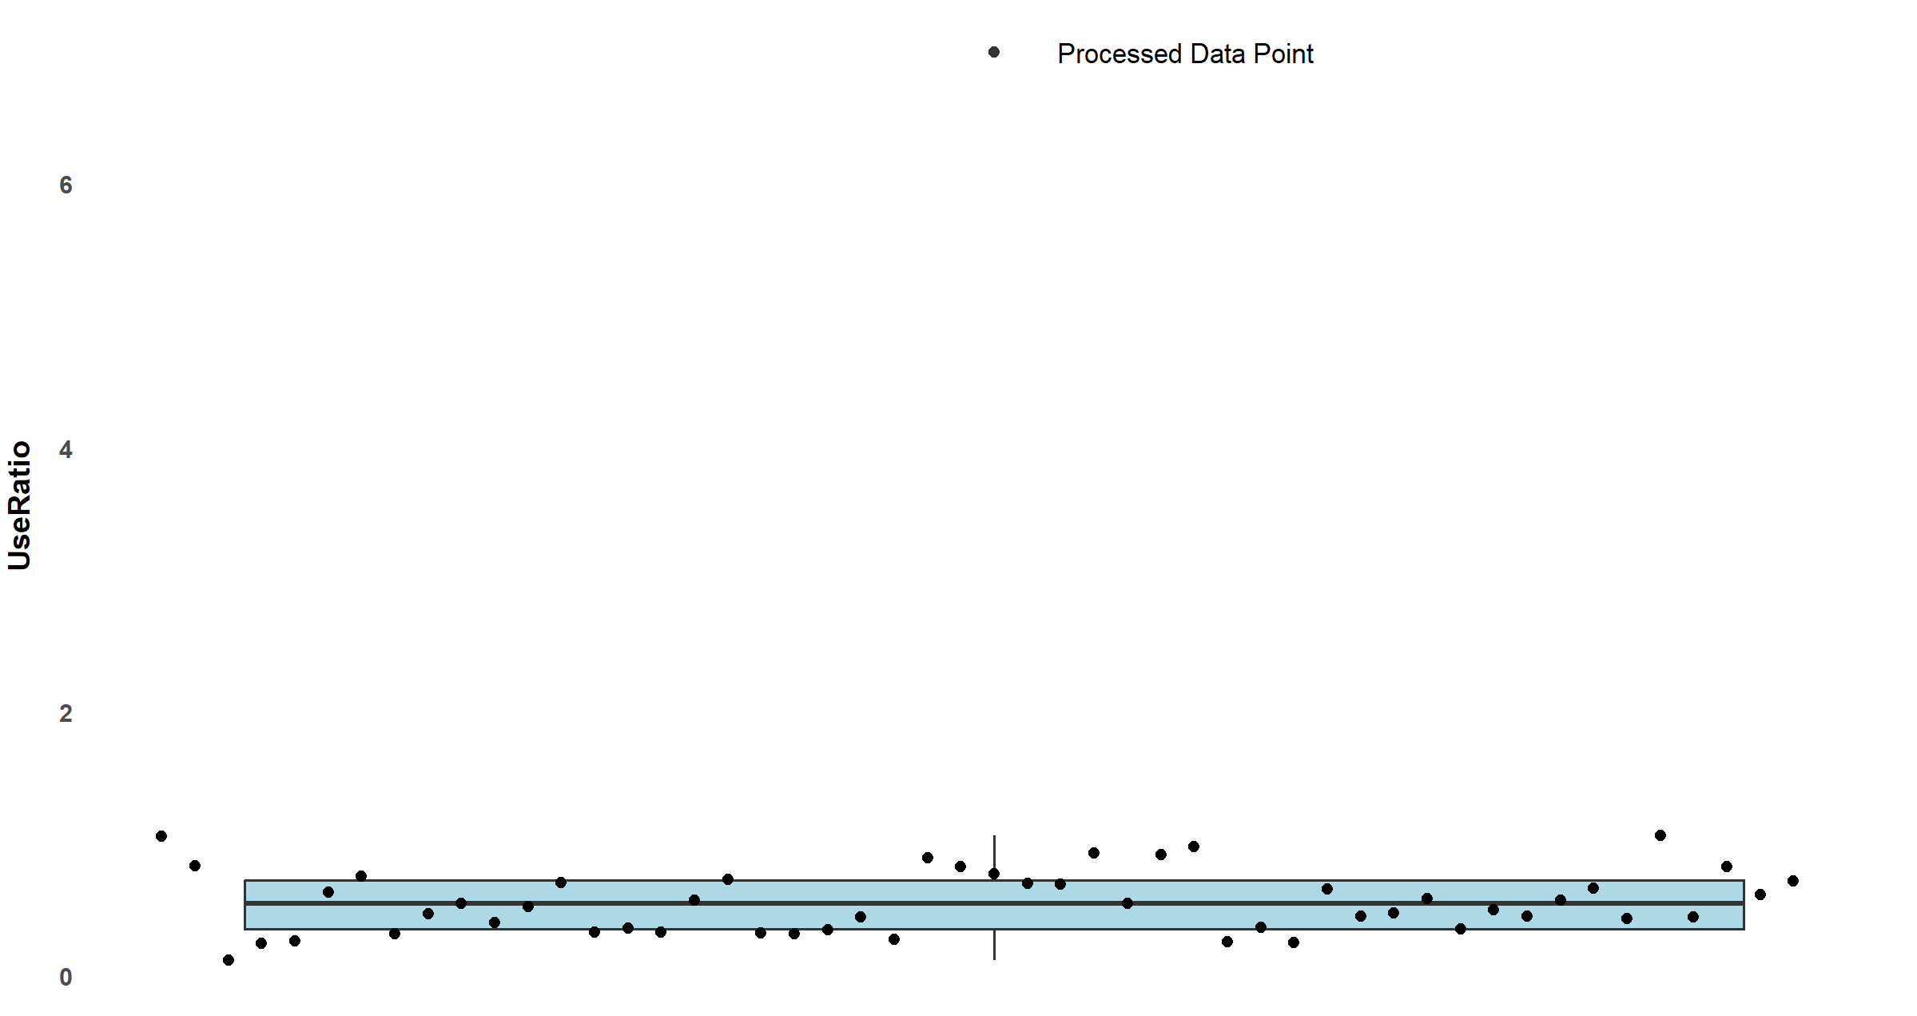
Automated Quality Control Example
More affected vs. unaffected UL activity
Use
Ratio
Hrs Affected UL Activity
=
_______________________
Hrs Unaffected UL Activity
More unaffected vs. affected UL activity
Notes:
-Can be done during the processing step
-Or can be done later on when pulling all summary data together

Slide 47
Automated Quality Control Example
More affected vs. unaffected UL activity
Use
Ratio
Hrs Affected UL Activity
=
_______________________
Hrs Unaffected UL Activity
More unaffected vs. affected UL activity
Notes:
-Can be done during the processing step
-Or can be done later on when pulling all summary data together

Slide 48
Automated Quality Control Example
Where are the opportunities for errors and what steps can be taken to check for these?
Checkpoint 1:
Do data appear to have been collected correctly?
Checkpoint 2:
Does the data point of interest appear reasonable compared to other data?
Documentation that data point was inspected and any follow-up required

Slide 49
In summary…
Good data management and quality control is the foundation for any research project
Think about optimizing data management and quality control procedures early in study development and build in checkpoints to safeguard against errors
These efforts will pay off in:
Less likelihood of retracting article due to errors
Greater confidence in your scientific findings
Facilitate data sharing

Slide 50
Allison Miller, PT, DPT, PhD, NCS
Postdoctoral Research Scholar
miller.allison@wustl.edu

Slide 51
Data Sharing and Re-Use
Communicating Data through Visualization
Data Collection & Quality Control
Planning for Dissemination: Leveraging Data Science to Improve Reproducibility
Key Milestones in the Pathway to Publication
Notes:
Planning for dissemination/overview of data science and reproducibility: Grace
Data collection and quality control – Allison
Communicating data through visualization- Andrew
Data sharing and re-use- Keith

Slide 52

Data Visualization for Communication
The good, the Bad and the Ugly.
Dr. Andrew Hooyman, PhD, Gstat

Slide 53
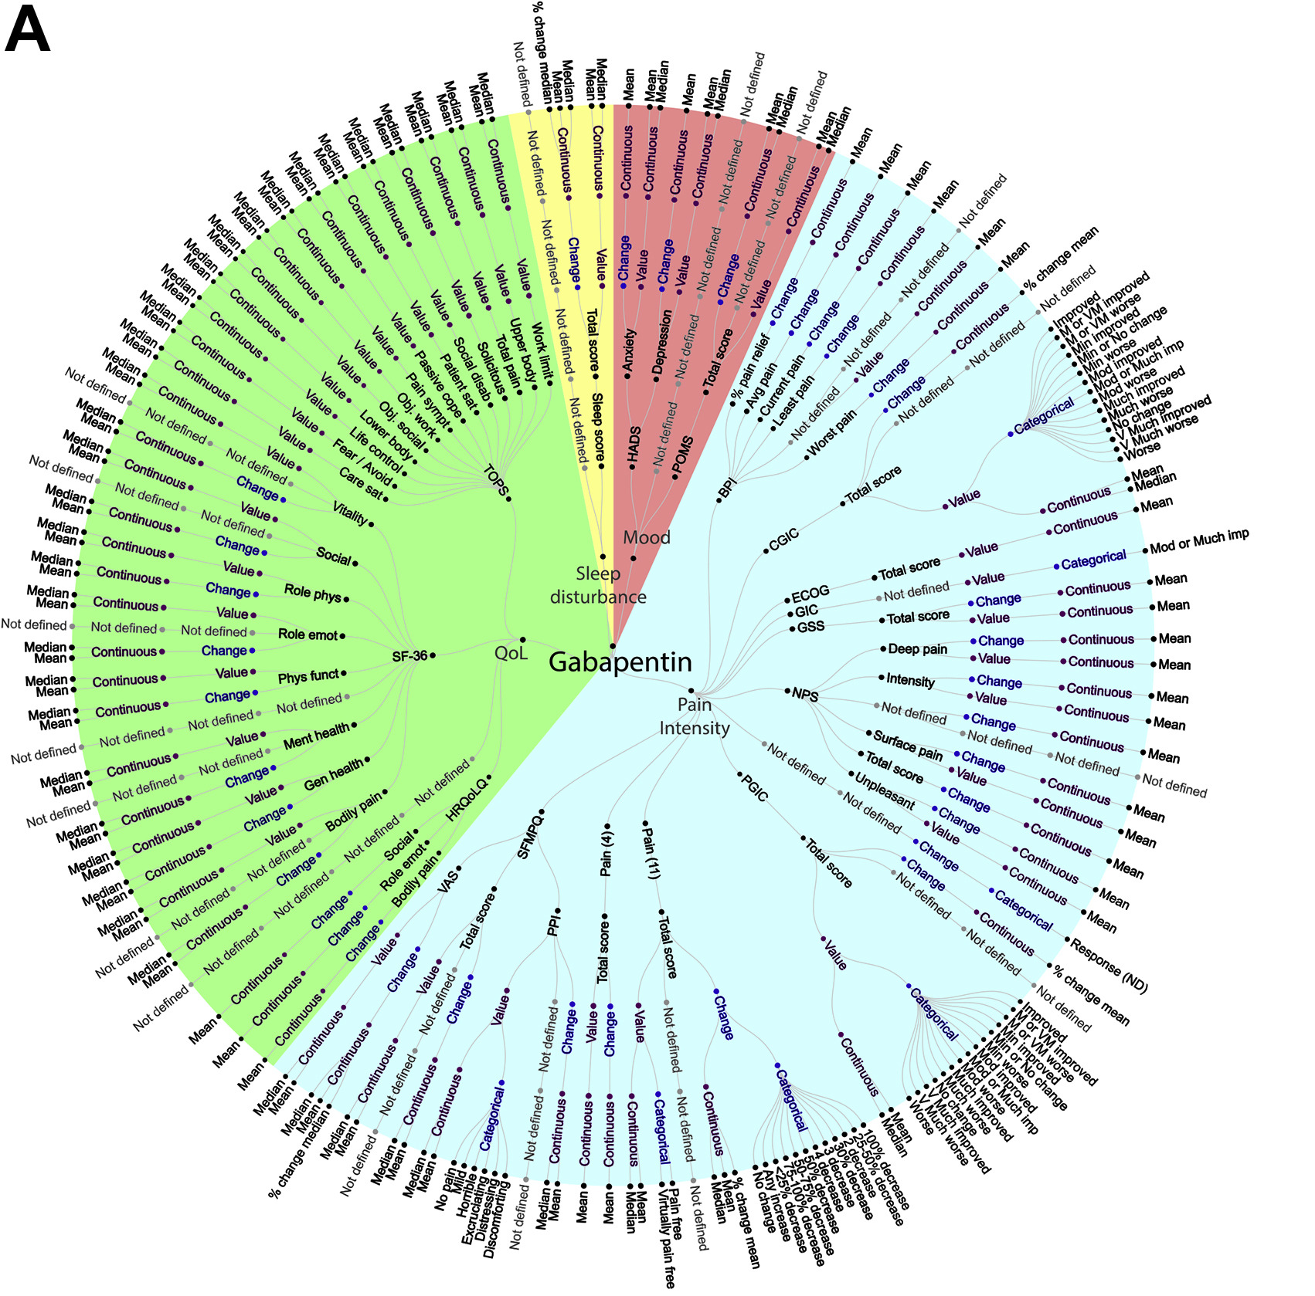

How I use Data Visualization
Visual of Reported Outcome
Measures for Neuropathic Pain
Mayo-Wilson et al. 2018
Data continues to get bigger, and analyses more complex.
Statistical jargon can also create confusion.
Regression versus linear model?
But a figure helps cut through the noise.

Slide 54
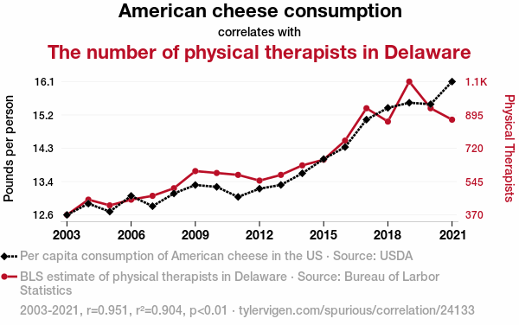
The Purpose of a Plot
Communicate measures of central tendency
Mean, median, mode
Communicate measures of dispersion
Standard deviation, range, interquartile range
Communicate statistical results
Linear and non-linear trends
Within and between group differences
Spurious Correlation #24,133
By Tyler Visgen

Slide 55
Purpose of a Plot (Continued)
Although the main goal of a graph is to communicate generalized measures and trends.
Visualization of individual participant data is informative and should be included.

Slide 56
The Purpose of a Plot
Communication Group and Individual Level Data
The key is achieving a balance
Not too little (Bad)
Not too much (Ugly)
Although our ability to visualize has advanced, the rules are still the same.

Slide 57
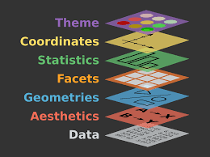
Rule 1: Start Simple and Build
Think of each graph as a blank canvas.
The data is the foundation.
Additional layers are placed
This approach allows maximum flexibility.

Slide 58
The Data for the Day
5110 Adults (243 with Stroke)
Mean (SD): 43.23 (22.61)
Gender: Female = 2994; Male = 2115
Additional Measures of:
Hypertension
Ever married
Work type
Residential Area
Average Glucose Level
BMI
Smoking Status

Slide 59
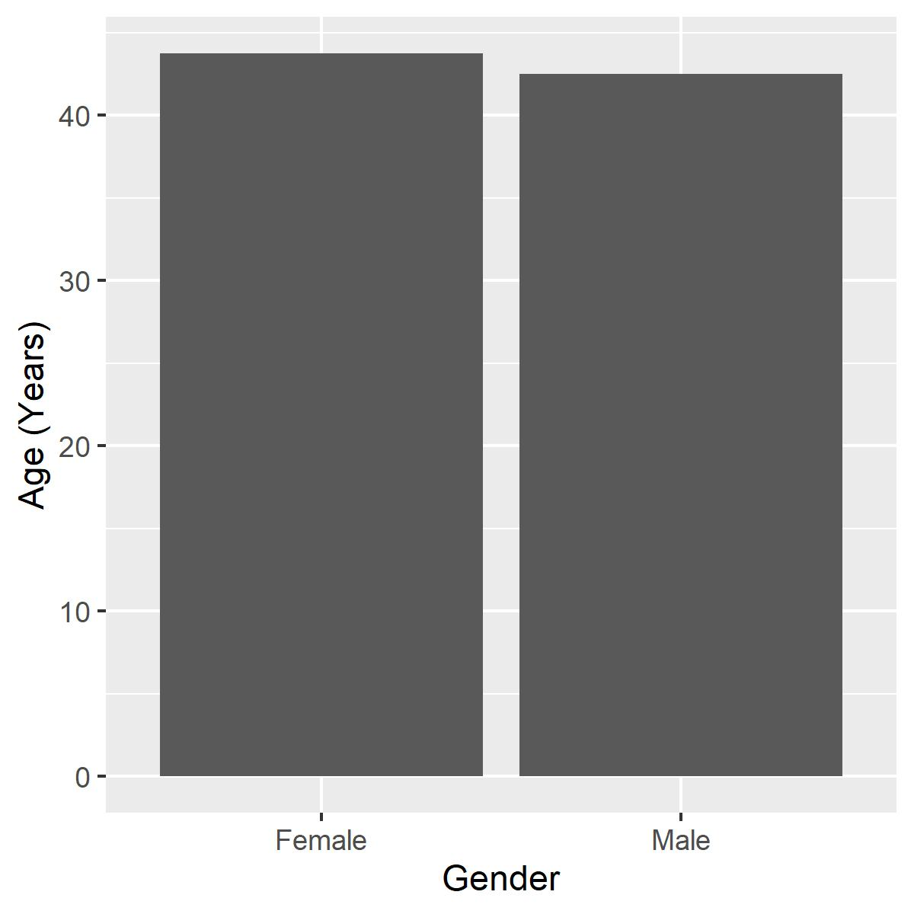
A Simple Start
The bar graph is old reliable.
But what is wrong with this visualization?
Too Simple.
Measure of Central Tendency.
No Dispersion

Slide 60
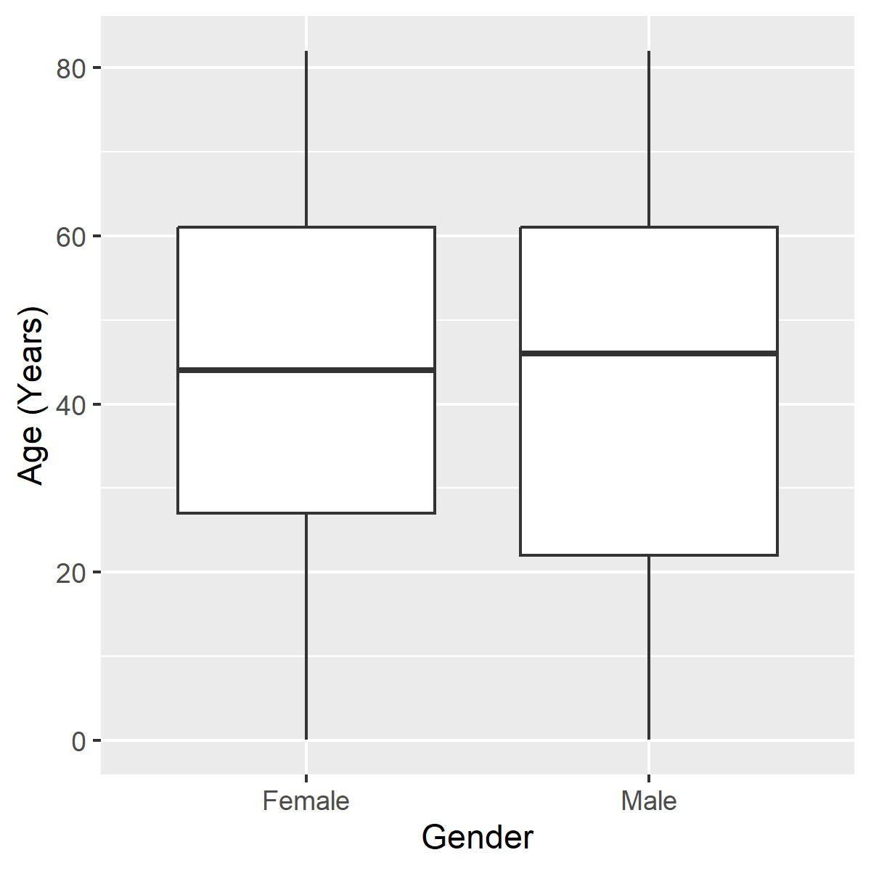
Box It Out
A box plot solves our first problems.
Measure of central tendency
Measure of dispersion
How could it be improved?

Slide 61
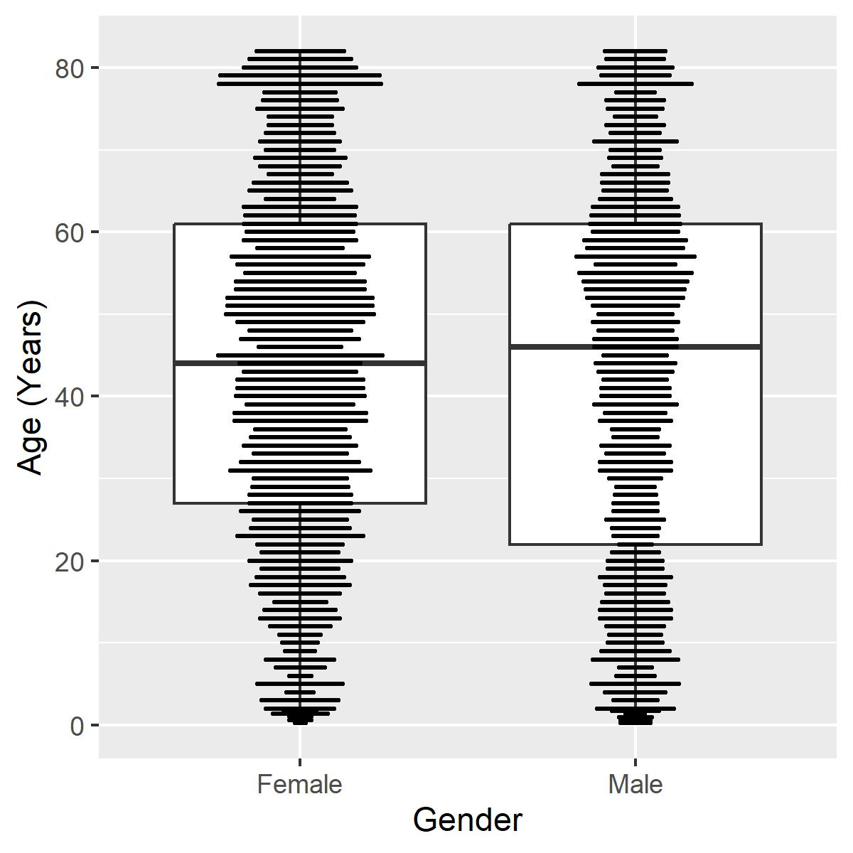
Layer it up
A box plot layered with a dot plot
Now we can see everything.
Getting kind of ugly.
Hard to compare distributions.

Slide 62
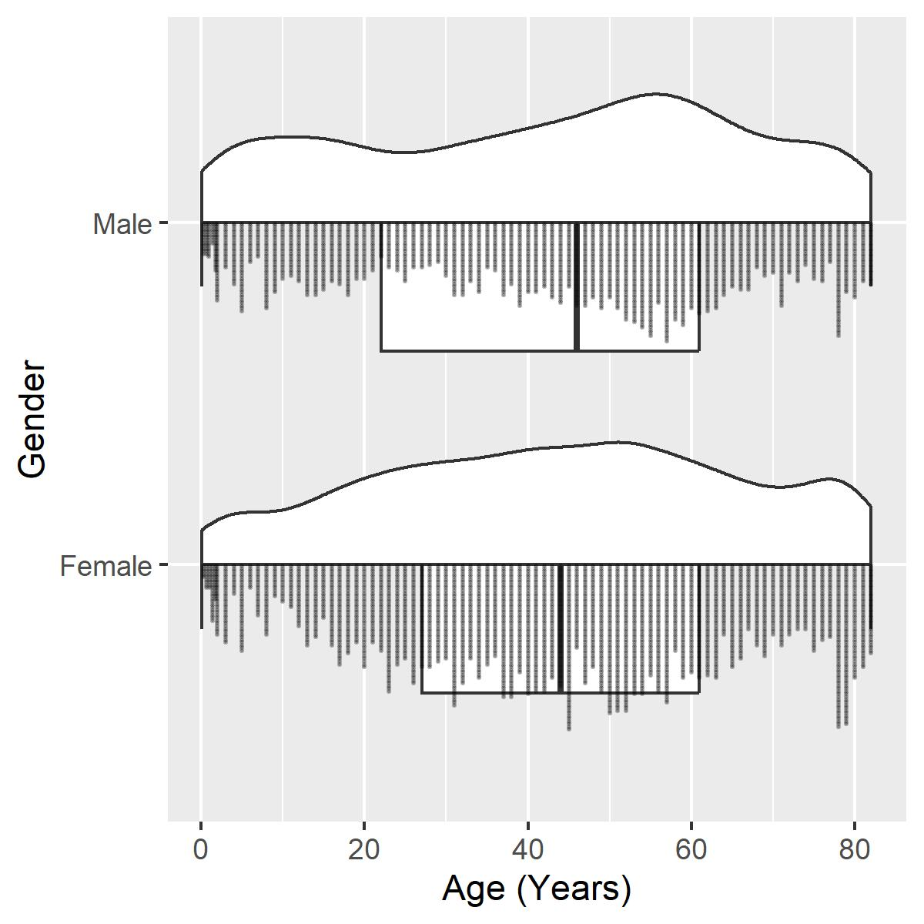
Flip it out
The rain cloud plot
A combination of a violin plot and a dot plot
Boxplot for good measure
Good visual of central tendency, dispersion and between group comparison.

Slide 63
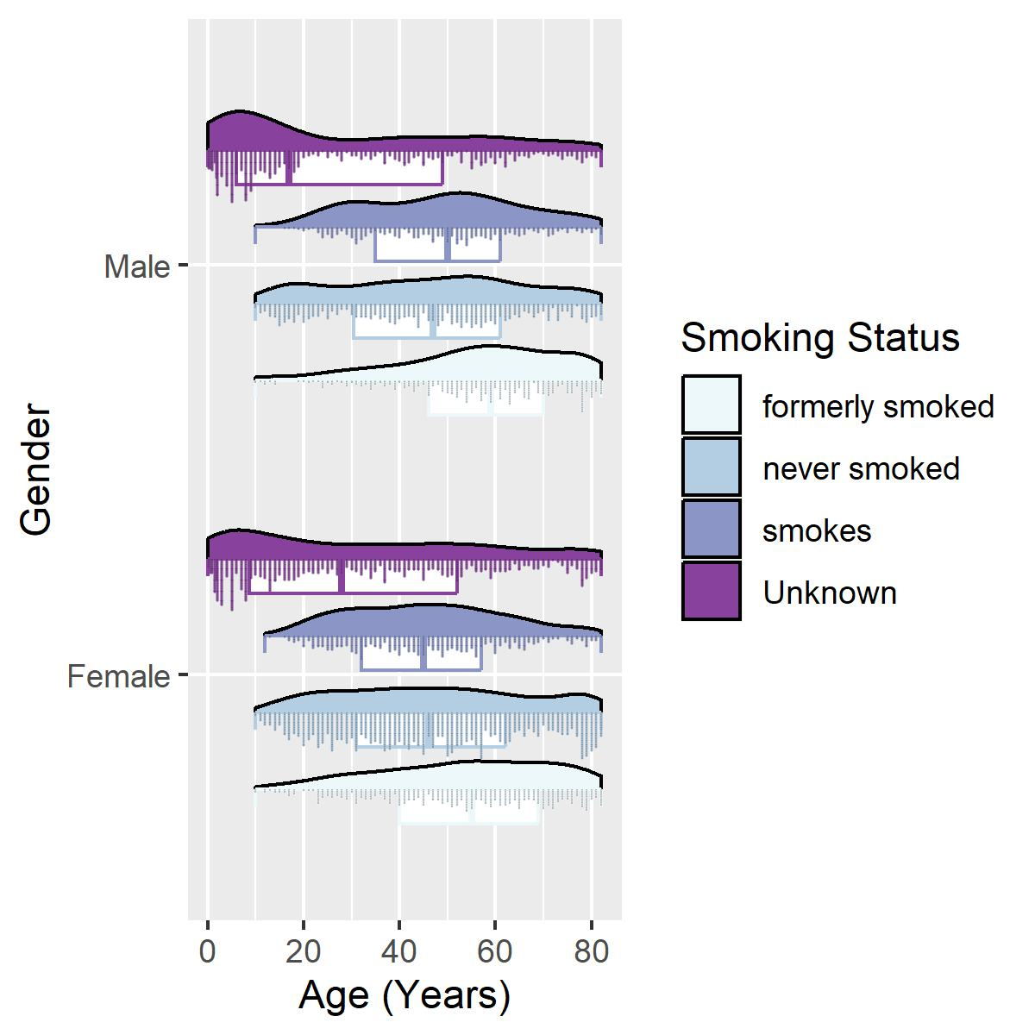
Visual of Sub-groups
What if we want to look within our primary groups?
We can use color to differentiate between sub-groups.

Slide 64
Visual of Sub-groups
What if we want to look within our primary groups?
We can use color to differentiate between sub-groups.

Slide 65
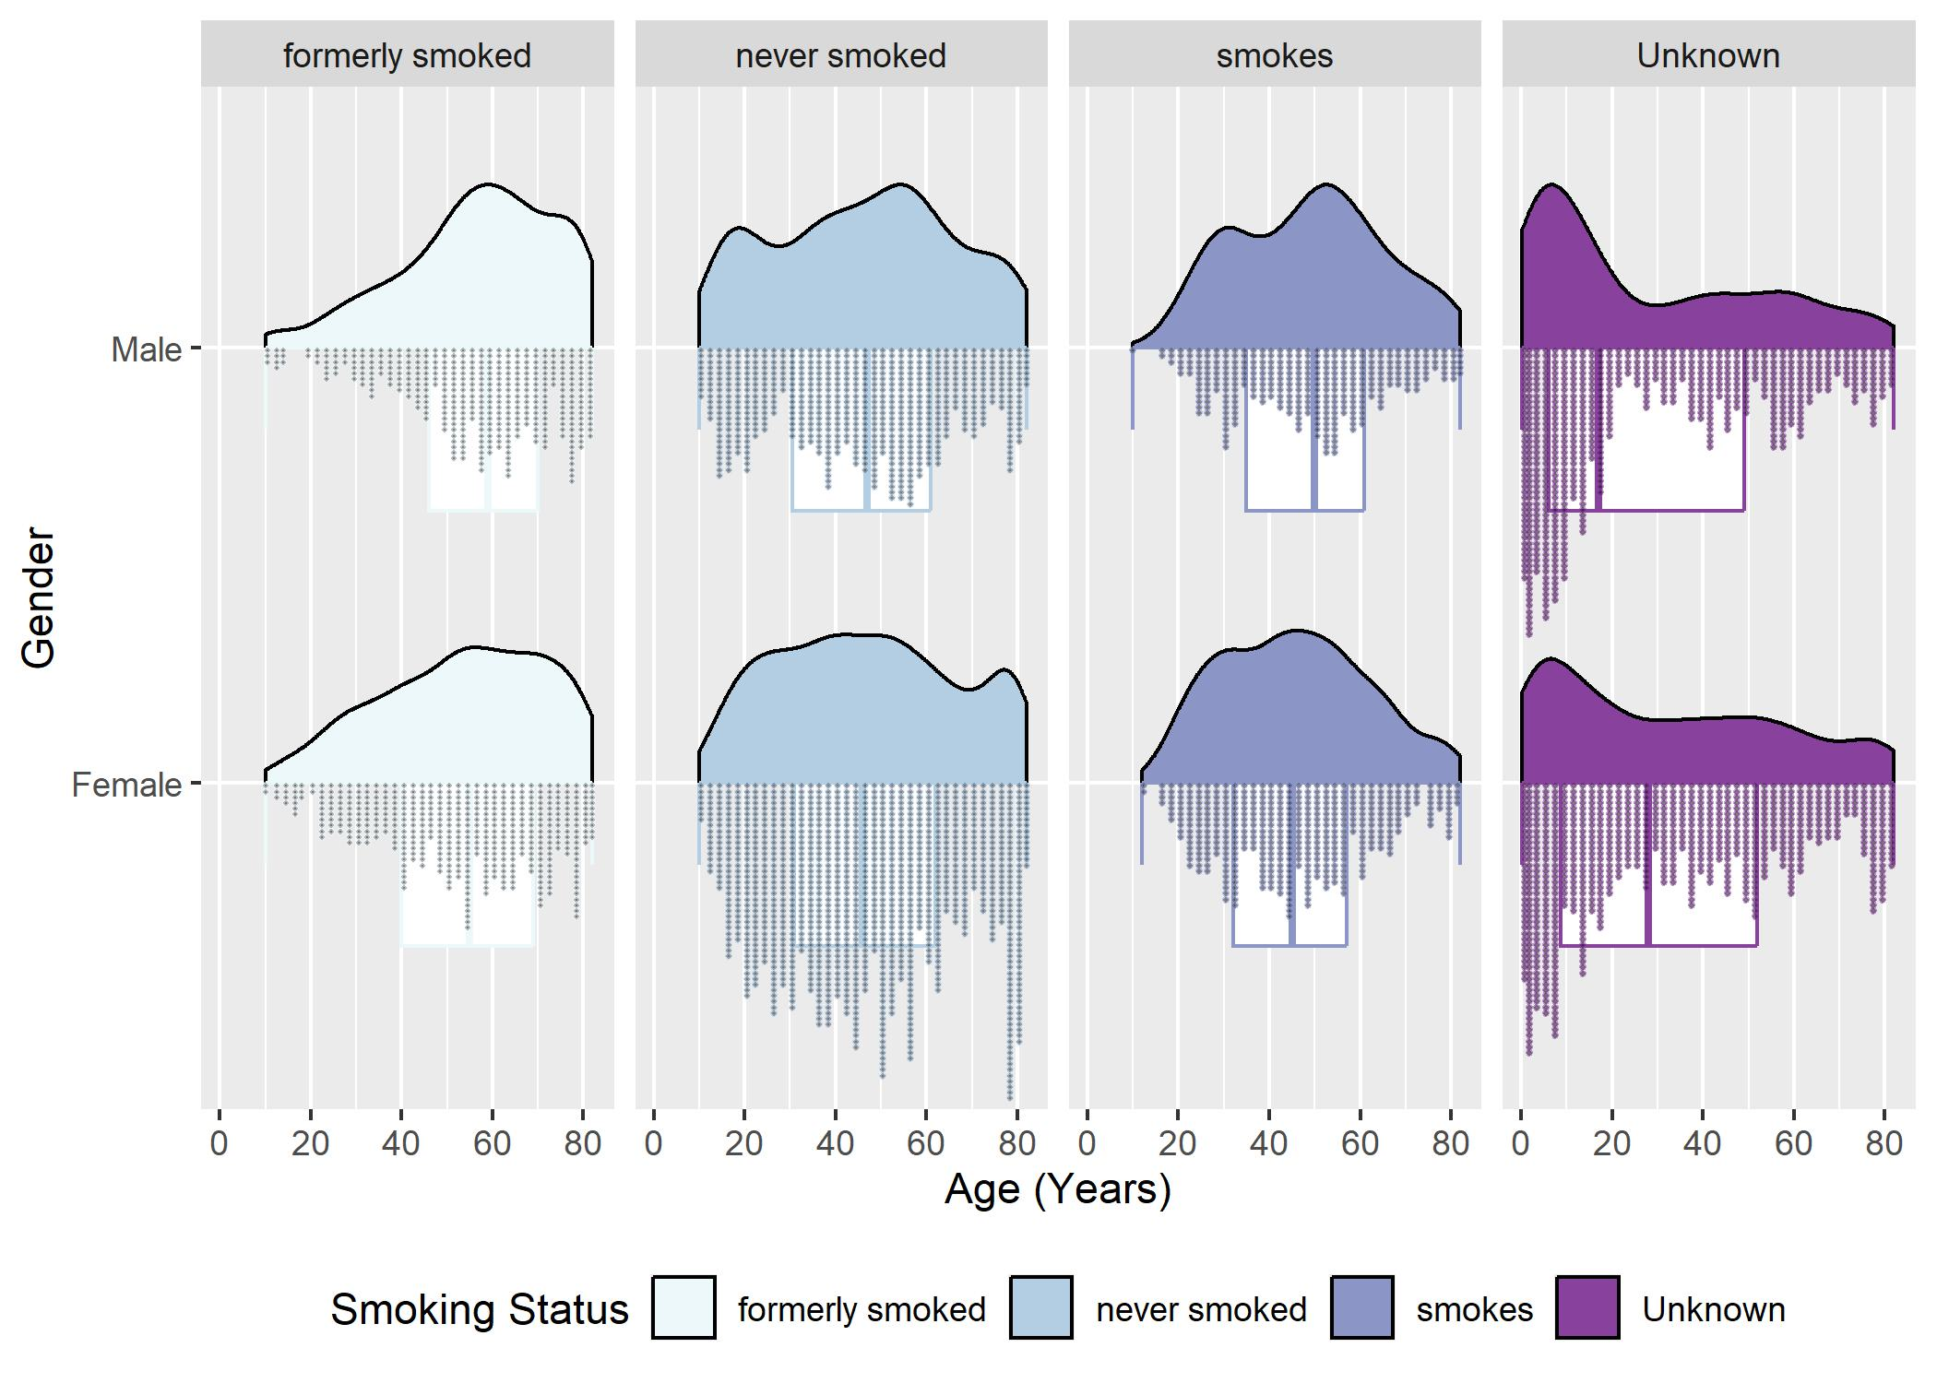
Visual of Sub-groups
We can use facets.
A facet is a method to show use several sides of the data.
Now we can compare different smoking status between our gender groups.

Slide 66
The Bad to Ugly to Good

Slide 67
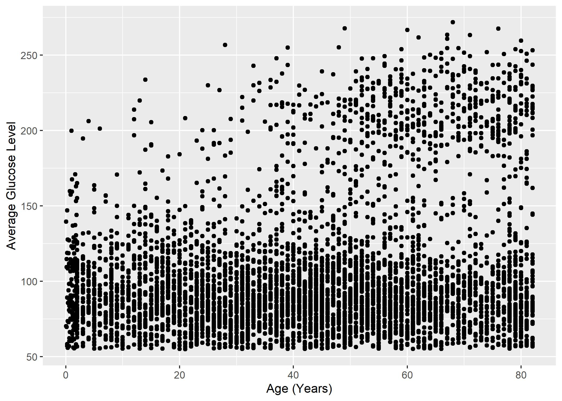
Switching Gears
How about a visualization between two continuous variables.
Can be important for identifying linear and non-linear trends.
Appears to be a lot going on here.

Slide 68
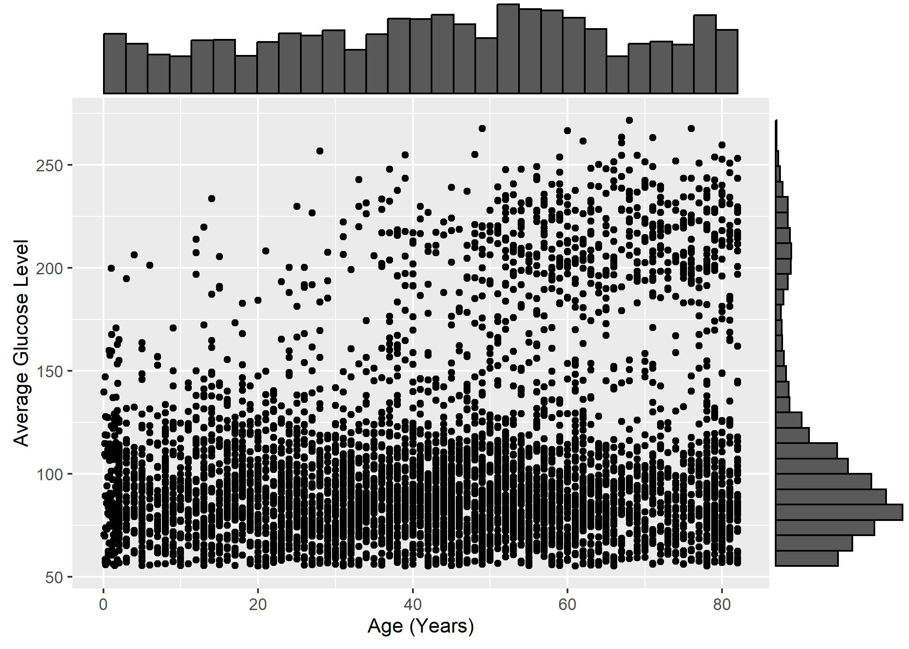
More Data, More Problems
The reverse problem has occurred now.
We see the individual data but we would like some idea of the group.
Fitting histograms can inform about skewness.

Slide 69
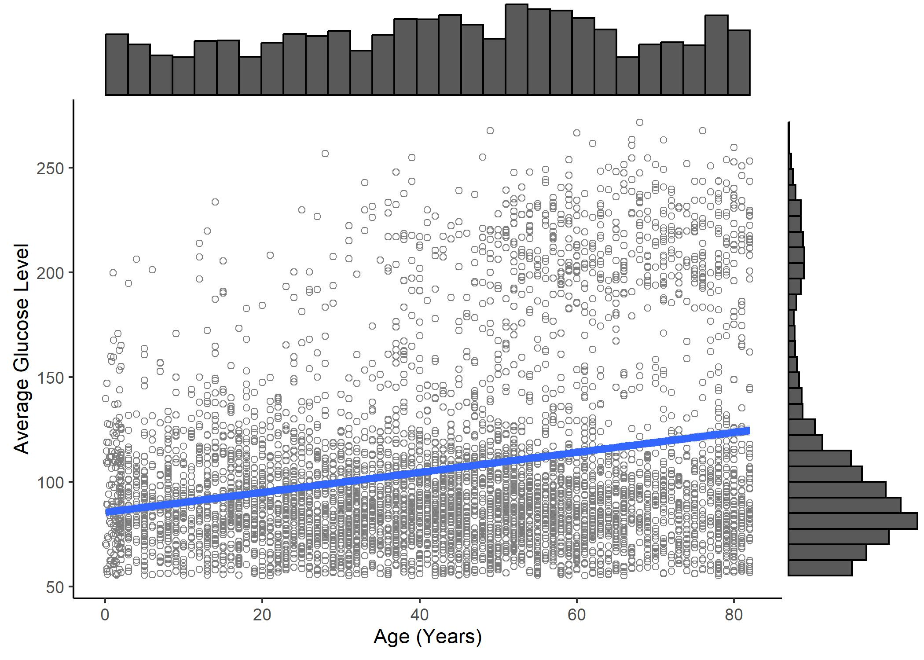
Visualize Linear Trend
If we have a research question on association, we need to create contrast.
Changing the theme of the plot and the shape and transparency of the scatter better reveals the fit.

Slide 70
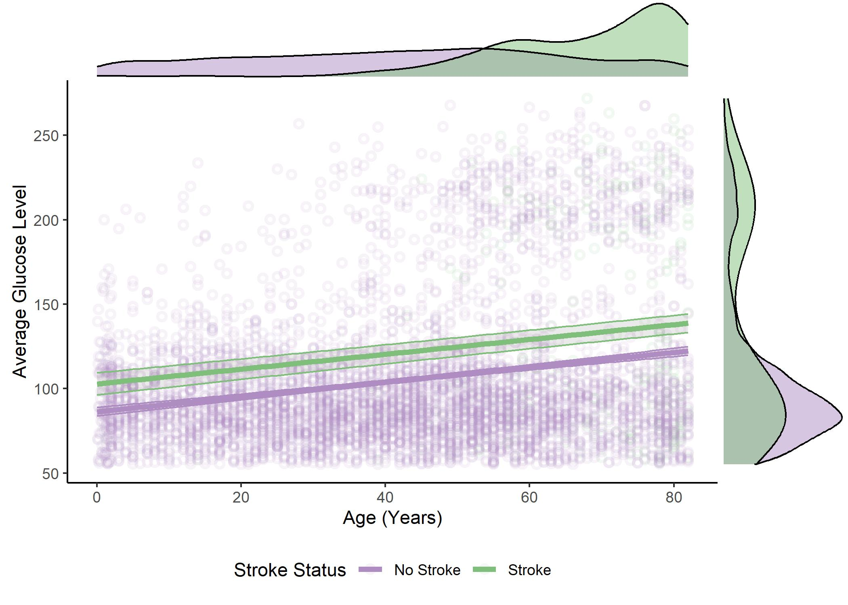
Group Trends
As a figure gets more complicated it can be a challenge to present the right focus.

Slide 71
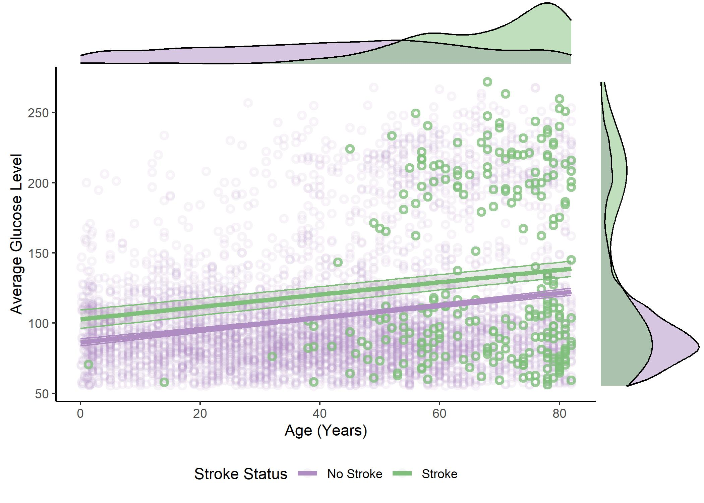
Group Trends
But you can choose how to highlight data specific to the result being conveyed.

Slide 72
The Bad to Ugly to Good

Slide 73
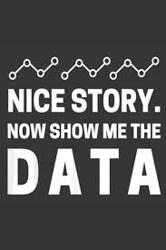
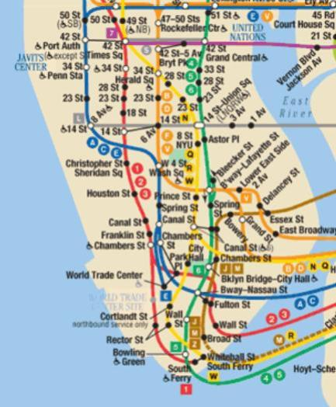
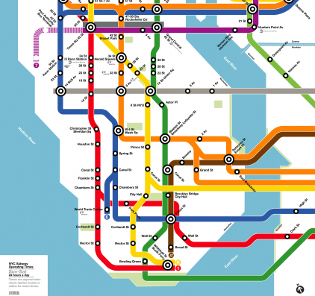
In Conclusion
Bad graphs leave us wanting more.
Show us the data!
Ugly graphs give us too much.
The goal should be clarity over flexing analytical muscle.
Good graphs have focus and convey a clear message.
Guide the reader to the result

Slide 74

Thanks for your time!
Contact: hooyman@chapman.edu
Big thanks for George Fulk for organizing.
If you want to learn about coding for rehabilitation research check out reprorehab!

Slide 75
Data Sharing and Re-Use
Communicating Data through Visualization
Data Collection & Quality Control
Planning for Dissemination: Leveraging Data Science to Improve Reproducibility
Key Milestones in the Pathway to Publication
Notes:
Planning for dissemination/overview of data science and reproducibility: Grace
Data collection and quality control – Allison
Communicating data through visualization- Andrew
Data sharing and re-use- Keith

Slide 76

(Data) Sharing is Caring:
Taking steps to open data in physical therapy and rehabilitation science.
Keith Lohse, PhD, Pstat
Washington University School of Medicine in Saint Louis

Slide 77
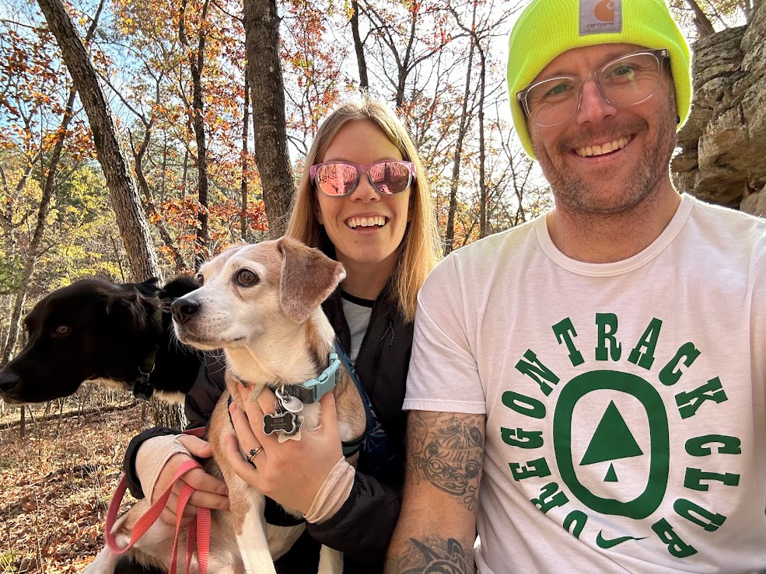

My work focuses on biostatistics, evaluating evidence, and research design (BERD) in neurological rehabilitation and recovery.
As a methodologist/applied statistician:
I specialize in longitudinal data, multivariate data, and generalized mixed-effect models.
I collaborate with research teams on study design, data sharing, and evaluating scientific evidence (meta-analysis/CPGs).
I teach sections on rigor and reproducibility for the ICTS at WashU, and I am ELT member for the NIH funded “ReproRehab” program.

Slide 78

My goal is to help you find a data sharing solution that works for you!
A big part of this talk is giving you resources that you can use in the future.
Please feel free to take pictures of any of the slides.
I also include QR codes to make it easy you get copies of these resources (like this one for a pdf of my slides themselves!).
And if you have any questions down the road, please do not hesitate to email me: lohse@wustl.edu
Slides!

Slide 79
Roadmap
Why Data Sharing?
Benefits
Accelerating Scientific Discovery
Enhancing Collaboration and Interdisciplinary Research
Improving Transparency and Reproducibility
Concerns (and how we can address them)
Privacy and Ethical Considerations of Participants
Recognition for Data Sharing and Intellectual Contributions
Misuse, Misinterpretation, and Muddy Waters

Slide 80
Roadmap
Why Data Sharing?
Benefits
Accelerating Scientific Discovery
Enhancing Collaboration and Interdisciplinary Research
Improving Transparency and Reproducibility
Concerns (and how we can address them)
Privacy and Ethical Considerations of Participants
Recognition for Data Sharing and Intellectual Contributions
Misuse, Misinterpretation, and Muddy Waters

Slide 81
Why data sharing?
Billions of dollars are spent in biomedical research every year. [Macleod et al., 2014; Røttingen et al., 2013]
Research is, by definition, an uncertain endeavor and many tested hypotheses are not supported.
Few studies lead to actionable new knowledge that directly advances a scientific theory or changes clinical practice.
At least not immediately. Even when “successful,” the time from proof-of-principle to outcomes like commercialization or policy is estimated to be more than 15 years. [Balas & Boren, 2000; Grant et al., 2003]

Slide 82
Research waste is a problem.
Given these lengthy timelines, it is frightening that meta-scientific researchers estimate that greater than 50%–80%, of research funding is wasted. [Glasziou & Chalmers, 2018; Macleod et al., 2014]
And a major source of waste is limited access to existing data. [Chan et al., 2014]
Lack of access can create waste from either a “file drawer” effect in which not all data are published and available, or from down-stream effects that a lack of data can have on future studies.
Expensive new data collection (“reinventing the wheel”) and can lead to poor study design—through poor sample size planning, poor outcome selection, or poor patient stratification; all create misleading results. [see Chan et al., 2014; Winstein, 2018]

Slide 83
Data sharing can reduce research waste.
I’ll generally be arguing for open data but recognize that open data is an ideal.
Not all data can or should be open and I consider some of those issues.
Along the way, I identify several resources for researchers interested in sharing their data:
Including data sharing in informed consent,
drafting data sharing plans for grants,
finding a suitable digital repository for your data,
and adhering to FAIR data principles.
Notes:
The benefits of data sharing are so crucial that numerous governments now make data sharing the default policy for federally funded research (e.g., Open Research Europe, n.d.; OSTP, 2022).

Slide 84
Roadmap
Why Data Sharing?
Benefits
Accelerating Scientific Discovery
Enhancing Collaboration and Interdisciplinary Research
Improving Transparency and Reproducibility
Concerns (and how we can address them)
Privacy and Ethical Considerations of Participants
Recognition for Data Sharing and Intellectual Contributions
Misuse, Misinterpretation, and Muddy Waters

Slide 85
1. Accelerating Scientific Discovery
One of the most significant benefits of open data sharing is its ability to accelerate scientific discovery.
When researchers have access to a wealth of data from previous studies, they can:
analyze and synthesize this information to generate new insights (e.g., Ferguson et al., 2014),
validate findings by catching and fixing errors (e.g., Ohmann et al., 2021),
and uncover patterns that may not have been apparent in individual data sets (e.g., Olafson et al., 2024).

Slide 86
2. Enhancing Collaboration and Interdisciplinary Research
Top Down
Bottom Up
Coordinated data collection and sharing between consortia (a priori)
Individual teams share data and data are aggregated as needed (post hoc)

Slide 87
3. Improving Transparency and Reproducibility
Recently, there have been notable replication failures in many areas of science and medicine. [e.g., OSC, 2015; Errington et al., 2014; Prinz et al., 2011]
Poorly designed trials and poor statistical analyses undeniably contribute to research waste. [e.g., Ioannidis et al., 2014]
Although the scope of the problem depends on how we define “replication”. [Patil, Peng, & Leek, 2014]
If the data are… | Same |  | Different
And methods are… | Same | Different | Same | Different
And the result is… | Same | Same | Same | Same
Then the findings are… | Reproducible | Robust | Replicable | Generalizable
[Lohse, 2024; Schloss, 2018]

Slide 88
Roadmap
Why Data Sharing?
Benefits
Accelerating Scientific Discovery
Enhancing Collaboration and Interdisciplinary Research
Improving Transparency and Reproducibility
Concerns (and how we can address them)
Privacy and Ethical Considerations of Participants
Recognition for Data Sharing and Intellectual Contributions
Misuse, Misinterpretation, and Muddy Waters

Slide 89
1. Privacy and Ethical Considerations
One of the primary concerns associated with open data sharing is the potential for breaches of privacy and ethical concerns around data security, particularly when dealing with sensitive information.
Open data must be deidentified (e.g., adhering to HIPAA “Safe Harbor” guidelines) and generally regarded as low risk, so that even if a participant’s identity could be reconstructed there is minimal risk.
However, there are many situations in which it is desirable to have at least some restrictions on data access.
Different repositories will have different levels of access and permissible uses for different types of data.

Slide 90


Include appropriate language for data sharing in your informed consent.
Let participants know what kind of data will be stored/shared.
Banked blood samples
Genetic data
Neuroimaging data
Behavioral data
Let participants know who will have access and to what purposes.

Slide 91
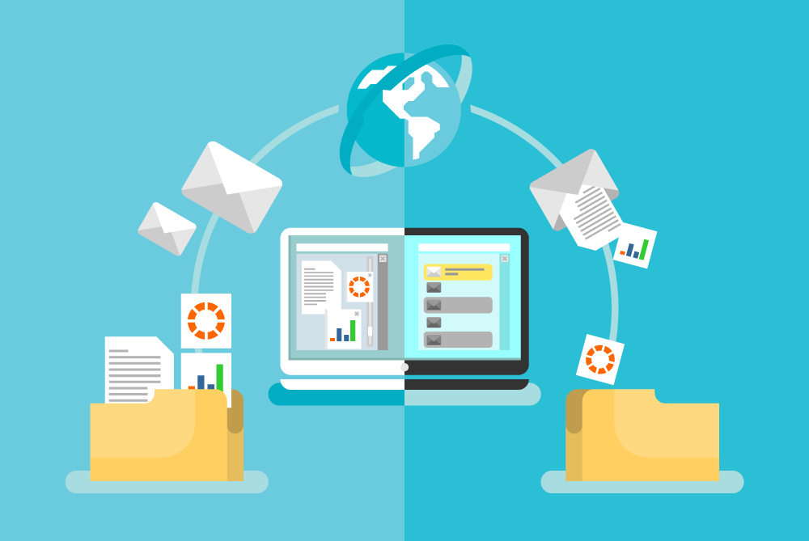

Write an effective data sharing plan in your grant application.
Data Types. Briefly describe the scientific data to be managed and shared ...
Related Tools, Software and/or Code. ...
Data Standards (if applicable) ...
Data Preservation, Access, and Timelines. ...
Access, Distribution, or Reuse Considerations...
Oversight of Data Management and Sharing…

Slide 92
2. Recognition for Data Sharing and Intellectual Contributions
The 2023 State of Open Data survey showed that over the last 8 years, researchers remain concerned about not receiving sufficient credit for openly sharing their data. [Hahnel et al., 2023]
Data can be shared as a stand-alone product with a digital object identifier, but this may not carry the same weight as peer-reviewed theory-driven work based on those data.
Getting scooped. If you share all your data, a different research team may use the data to test a hypothesis the you were interested in exploring!
Using data without co-authorship. The shared data are successfully reused by a new team, but there is no collaboration between the new team and the old team.

Slide 93


You do not need to share “all” data at once.
However, authors are generally not required to share all the data collected in a project.
For example, under the NIH Data Management and Sharing policy, researchers should “maximize the appropriate sharing of scientific data, which is defined as data commonly accepted in the scientific community as being of sufficient quality to validate and replicate the research findings.
Focus is on analytical reproducibility for the current work.
[Swiper, Dora the Explorer]

Slide 94
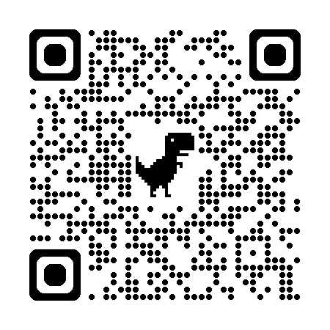
Find the repository that fits your needs!
Level of Restriction for Access and Use?
Researchers can find/select repositories that have different levels of permissions for data access and use.
The journal Scientific Data maintains a great guide on both general and specific repositories for scientific data with different levels of permissions.

Slide 95
3. Misuse, Misinterpretation, and Muddy Waters
I think the risk of misuse is relatively low in rehabilitation research.
I don’t think we have any analogues to climate change deniers trying to cherry-pick ecological data, or anti-vaccine quacks digging through the FDA’s Adverse Event Reporting System.

Slide 96
3. Misuse, Misinterpretation, and Muddy Waters
I think the risk of misuse is relatively low in rehabilitation research.
I think the risk of misinterpretation is greater in our field.
For instance, I can process and analyze biomechanical data, but I couldn’t give you a theoretically driven interpretation of what it means.
That is, however, where peer-review comes in as a (admittedly leaky) filter to control quality in publishing.
I may be able to fool myself that I understand biomechanics, but I doubt I could fool genuine experts.

Slide 97
3. Misuse, Misinterpretation, and Muddy Waters
I think the risk of misuse is relatively low in rehabilitation research.
I think the risk of misinterpretation is greater in our field.
I am most concerned about open data muddying the waters in our field by lowering the cost of doing research.
Systematic reviews and meta-analysis are an illustrative example of this phenomenon. [Ioannidis, 2016]
However, I think we can address this problem in two ways:
If data adhere to principles of Findability, Accessibility, Interoperability, and Re-usability [i.e., FAIR data principles; Wilkinson et al., 2016], then data are easy to find, understand, and use to the best of our ability.

Slide 98

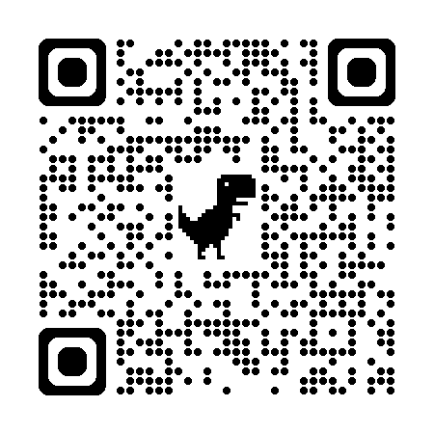



FAIR Data

Slide 99
3. Misuse, Misinterpretation, and Muddy Waters
I think the risk of misuse is relatively low in rehabilitation research.
I think the risk of misinterpretation is greater in our field.
I am most concerned about open data muddying the waters in our field by lowering the cost of doing research.
Systematic reviews and meta-analysis are an illustrative example of this phenomenon. [Ioannidis, 2016]
However, I think we can address this problem in two ways:
If data adhere to principles of Findability, Accessibility, Interoperability, and Re-usability [i.e., FAIR data principles; Wilkinson et al., 2016], then data are easy to find, understand, and use to the best of our ability.
If we value quality, rigor, and impact above quantity, publication, and notoriety, then open data allow us to do more thorough research, not less.
As Douglas Altman [1994] eloquently put it:
“We need less research,
better research,
and research done for the right reasons.”

Slide 100
Contact:
Keith Lohse, PhD, Pstat
lohse@wustl.edu
https://doi.org/10.1123/jmld.2024-0081
Special thanks to:
George Fulk, Andrew Hooyman, Grace Bellinger, and Allison Miller.
NIH/NICHD R25HD105583

Slide 101
Data Sharing and Re-Use
Communicating Data through Visualization
Data Collection & Quality Control
Planning for Dissemination: Leveraging Data Science to Improve Reproducibility
Key Milestones in the Pathway to Publication
Notes:
Planning for dissemination/overview of data science and reproducibility: Grace
Data collection and quality control – Allison
Communicating data through visualization- Andrew
Data sharing and re-use- Keith

Slide 102
Resources for Visualization
https://r-graph-gallery.com
https://r-charts.com
http://r-statistics.co/Top50-Ggplot2-Visualizations-MasterList-R-Code.html#google_vignette

Slide 103
Questions

